Slide 1
2015 Horizons Economic Forecast PCFC Meeting
Dr. Neal Johnson and Dr. Martin Wurm
Department of Economics, Pacific Lutheran University
ABBREVIATED BY
GARY BRACKETT
Tacoma-Pierce Co. Chamber
Feb. 5, 2015

Slide 2
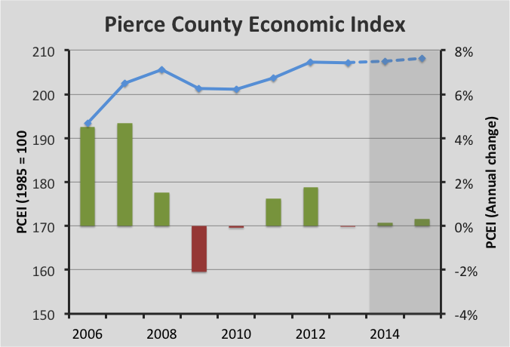

Slide 3
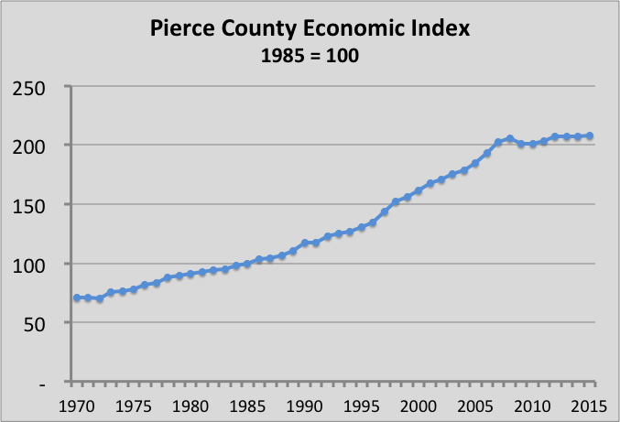

Slide 4
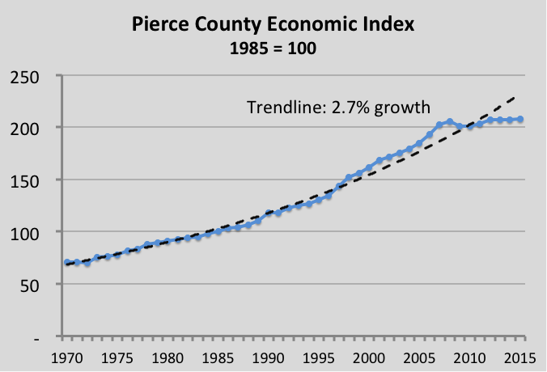

Slide 5
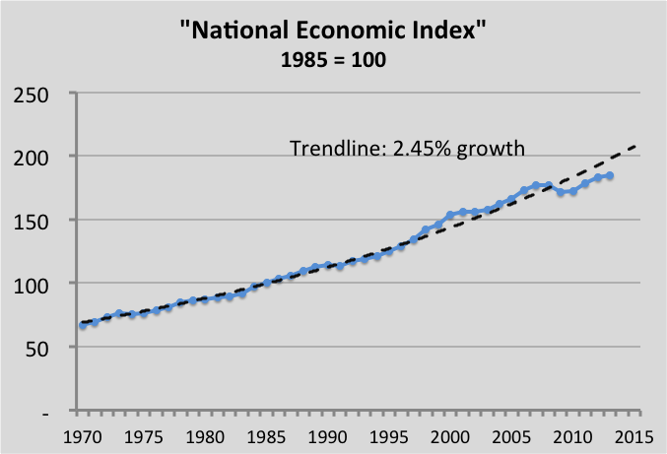

Slide 6
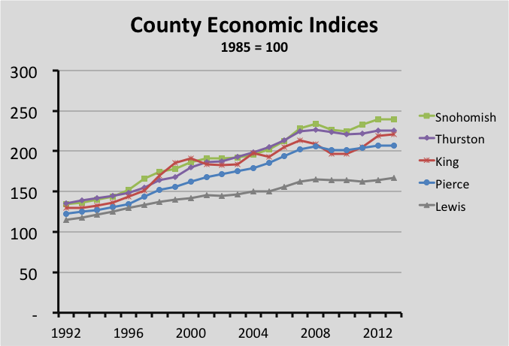

Slide 12
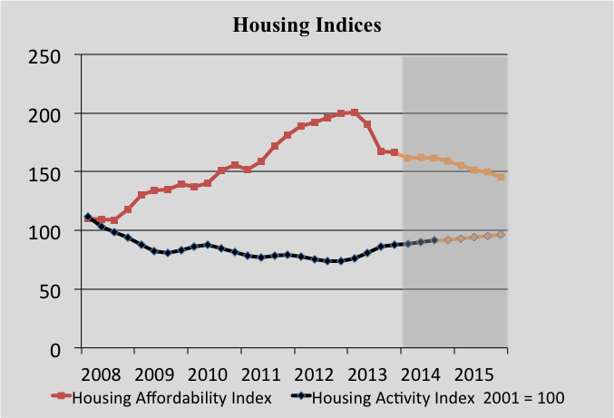

Slide 13
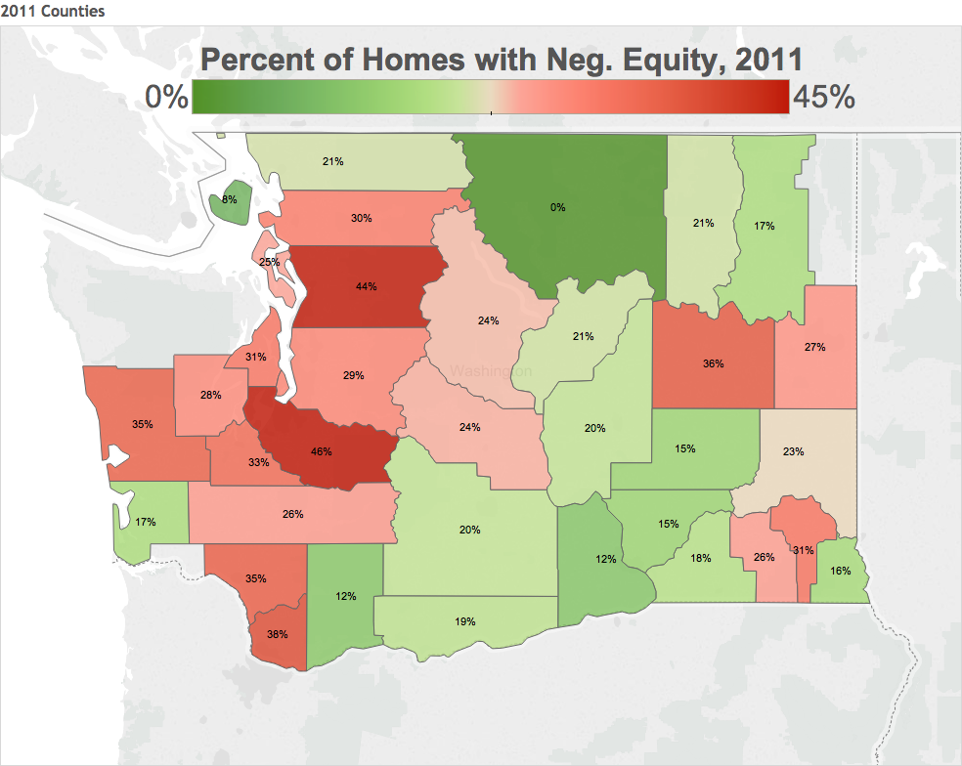

Slide 14
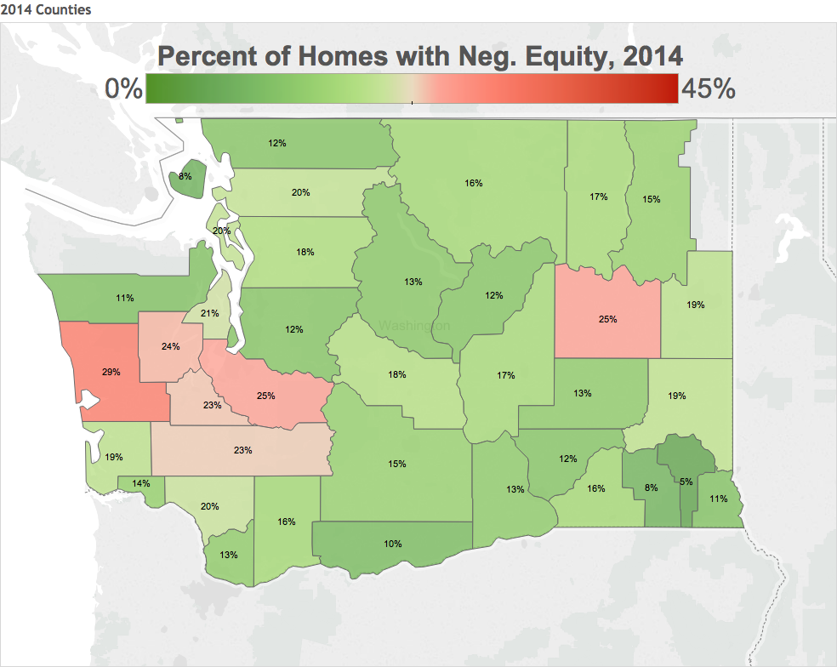

Slide 15
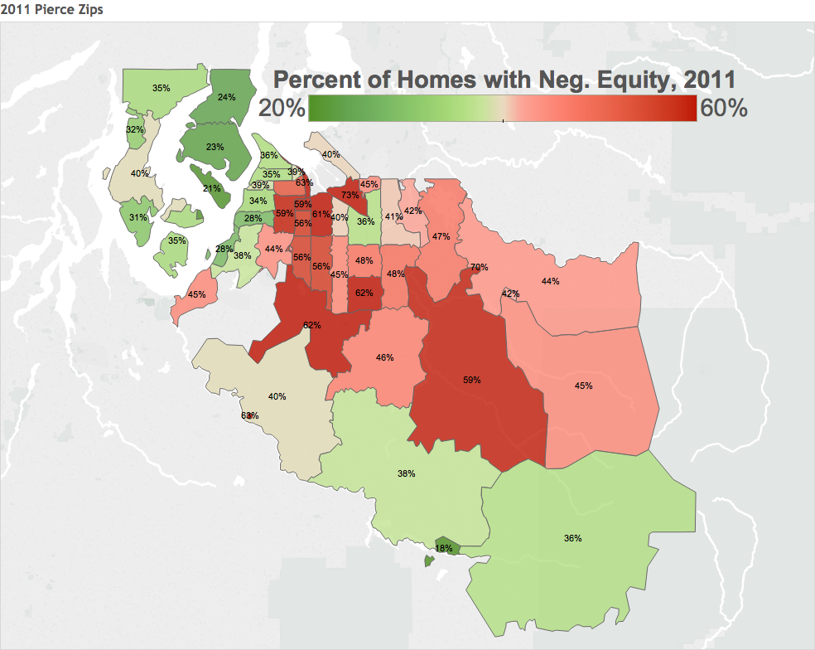

Slide 16
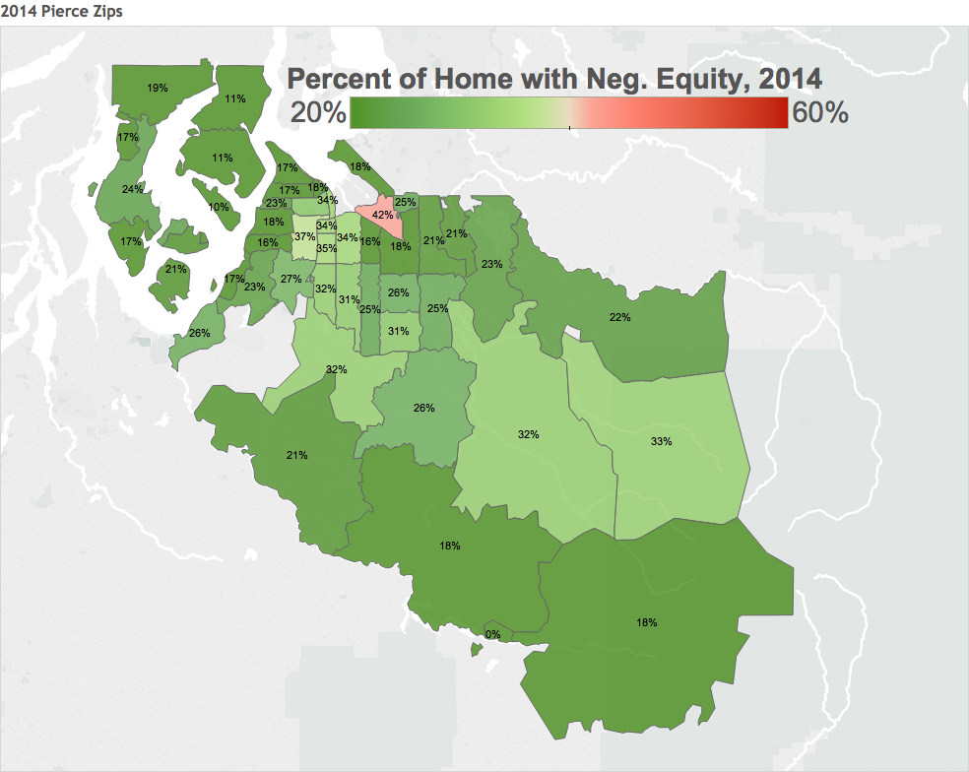

Slide 17
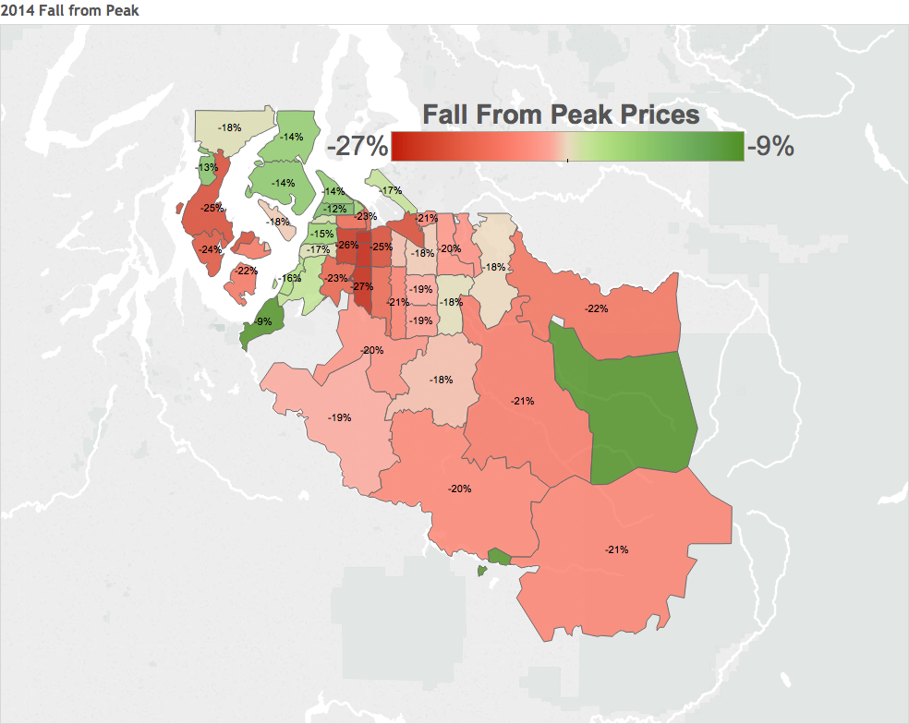

Slide 18
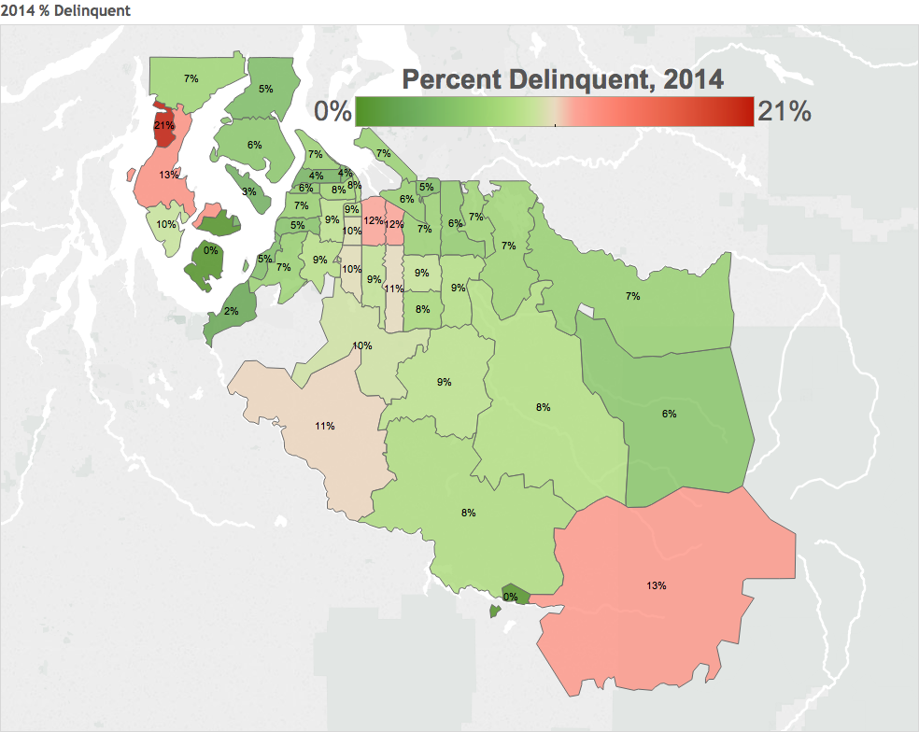

Slide 20
2015 Horizons Economic Forecast PCFC Meeting
ABBREVIATED BY
GARY BRACKETT
Tacoma-Pierce Co. Chamber
2/05/15
Dr. Neal Johnson and Dr. Martin Wurm
Department of Economics
Pacific Lutheran University

